Slide 1
Ultra Cold Progress Report
March 6, 2021

Slide 2
What is done
Refactored all fitting code into python package UltraCold
Ensures complete understanding of code.
Code style becomes more concise, “pythonic” and easy to work with.
Separated into different modules, highly extensible.
Design of Prediction Algorithm
Predict OD variance from a single OD image

Slide 3
Package UltraCold Structure
OD
from_image_dir()
Visualize()
NPS
from_od()
visualize_exp()
Visualize_exp_fit()
MTF
from_od()
Fit()
mtf_anal()
PupilFunc
Pupil_anal()
Visualize()
Plotting
Utils
Examples

Slide 4
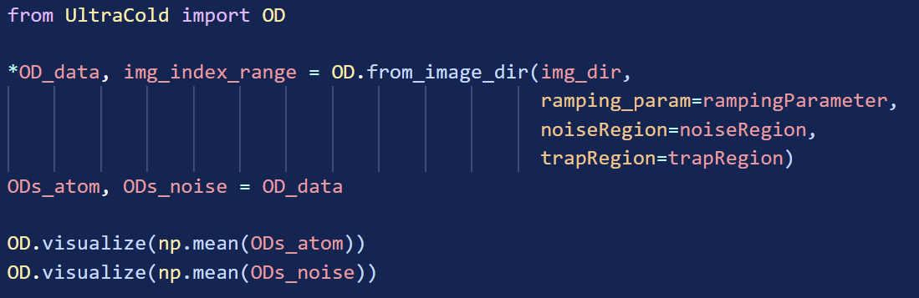
Main Difference
Object-Oriented, intuitive function names
Dry (low redundancy)
Simplified Functions (fewer arguments and returns)

Slide 5
Workflow of Traditional Algorithm
Calibration parameters
Raw Image
(Atom)
(No-Atom)
OD
(non-trap)
OD.from_image()
MTF.fit()
NPS.from_od()
Approximate
OD
(trap)
NPS
MTF

Slide 6
Workflow of Traditional Algorithm
Calibration parameters
Raw Image
(Atom)
(No-Atom)
OD
(non-trap)
OD.from_image()
MTF.fit()
NPS.from_od()
Approximate
OD
(trap)
NPS
MTF
Scope of Interest

Slide 7
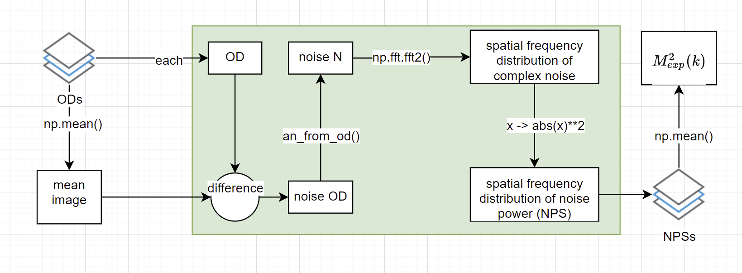
Workflow of NPS.from_od()
(NPSs_avg)

Slide 8
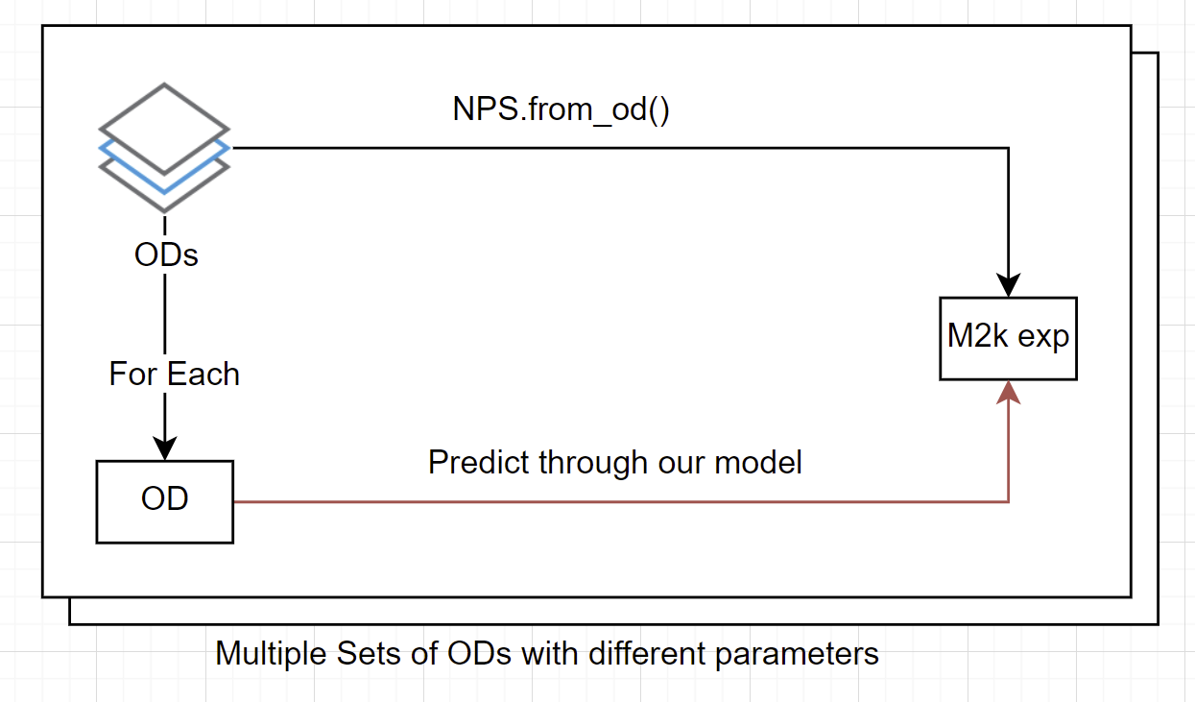
Prediction Problem
(NPSs_avg)

Slide 9
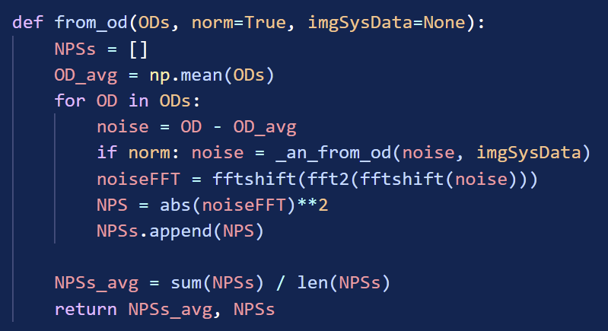
Put in another way,
We replace these code with an ML algo that only eats one OD at a time.

Slide 10
Prediction Strategy

Slide 11
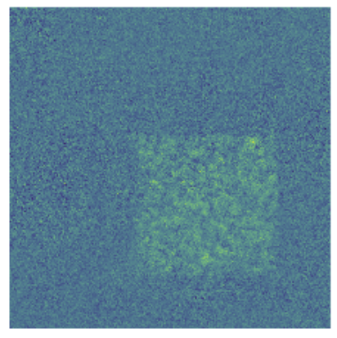
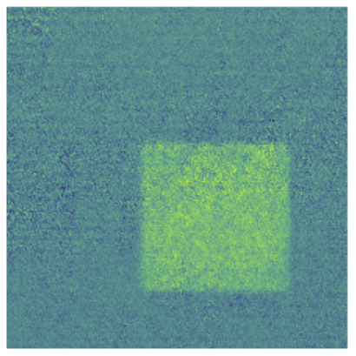
Prediction Strategy
Predictor 1
Predictor 2
Single OD
Mean NPS
NPS

Slide 12
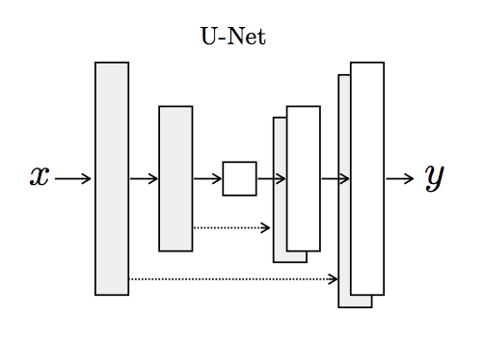
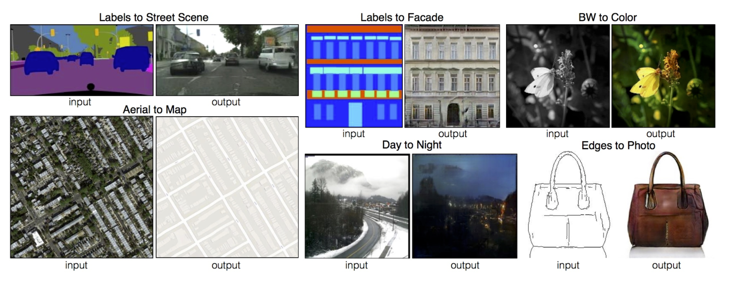
Implementation of Prediction
Image-to-image prediction problem
Input and output sizes: whole OD image = 300 * 300 px
Choice of Model: pix2pix
“a general-purpose solution to image-to-image translation problems” (Phillip et al.)

Slide 13
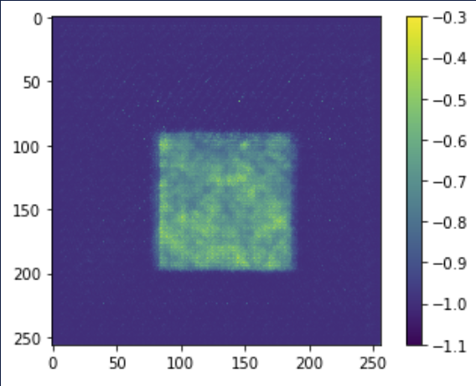
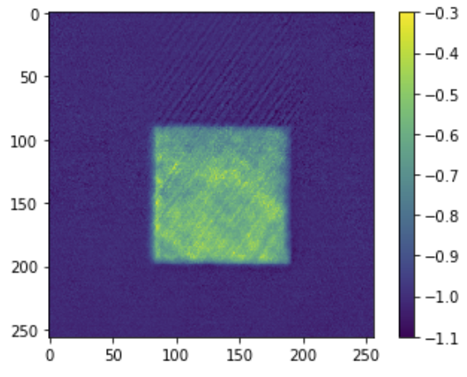
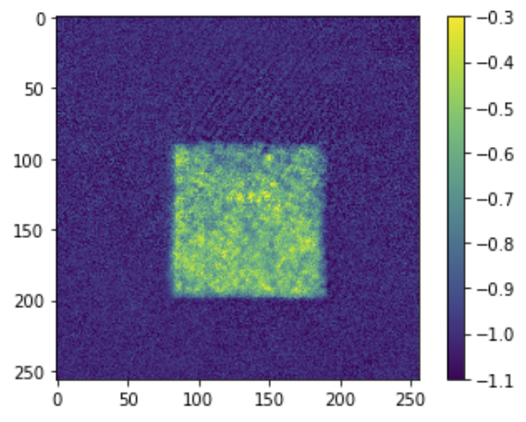
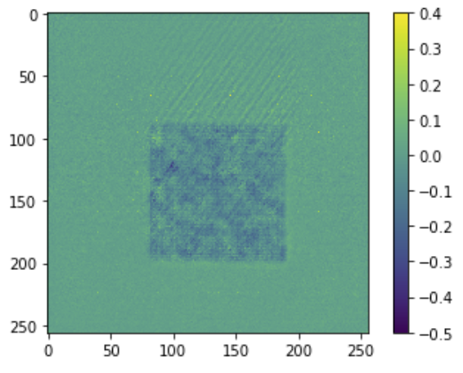
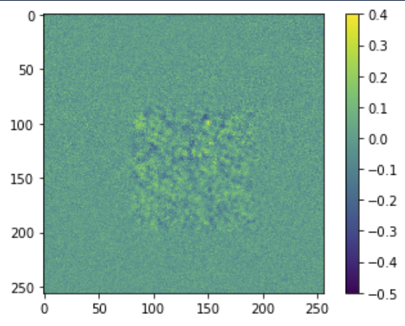
Result of OD prediction
OD mean pred
OD mean actual
Example of original OD
Predicted Mean
Ground Truth
Predicted Noise
Noise Ground Truth
OD
OD noise pred
OD noise actual

Slide 14
Implementation of Prediction
Image-to-image prediction problem
Input and output sizes: 64 * 64 px noise regions
Input: OD, Output: OD variance
Choice of Model: pix2pix
“a general-purpose solution to image-to-image translation problems” (Phillip et al.)

Slide 15
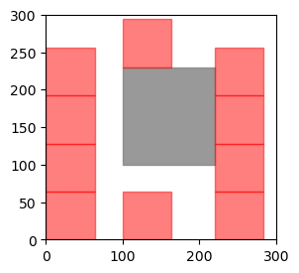
Randomized Sampling of Noise
Auto Labeling of Trap Region
Packing multiple Noise Regions
Shelf-based rectangle packing
Jylänki, Jukka. ‘A Thousand Ways to Pack the Bin-a Practical Approach to Two-Dimensional Rectangle Bin Packing’. Retrived from Http://Clb. Demon. Fi/Files/RectangleBinPack. Pdf, Citeseer, 2010.

Slide 16
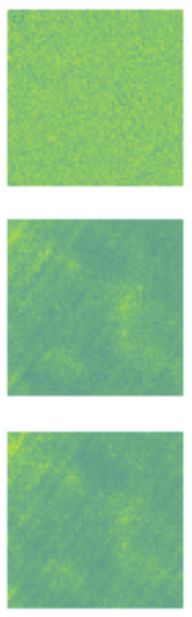
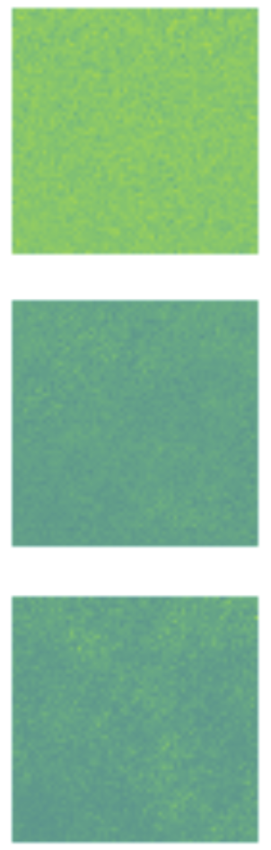
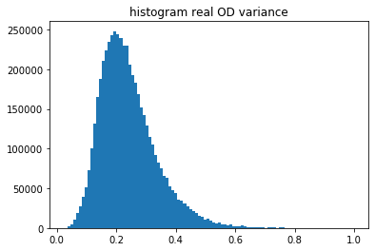
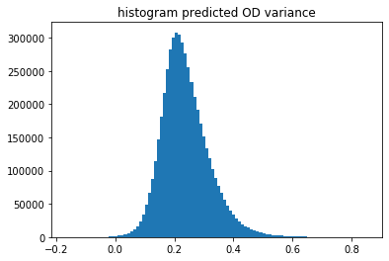
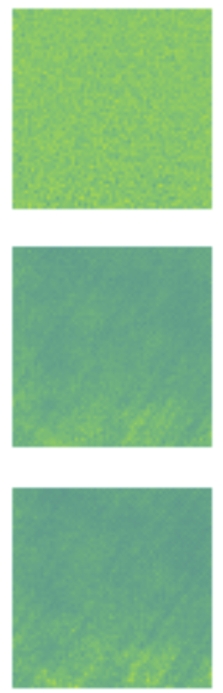
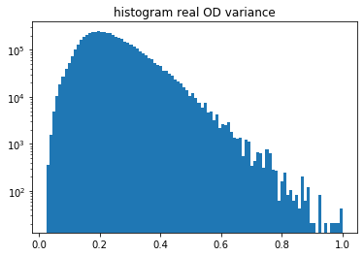
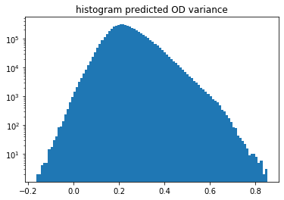


Predicting OD variance
OD
$σ_{\left\{OD\right\}}^{2}$ $pred$
$σ_{\left\{OD\right\}}^{2}$ $actual$
After 2000 steps, the loss stop dropping even train with more data.
2000 steps
7000 steps
10000 steps

Slide 17
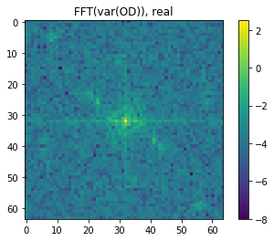

FFT of predicted variance

Slide 18


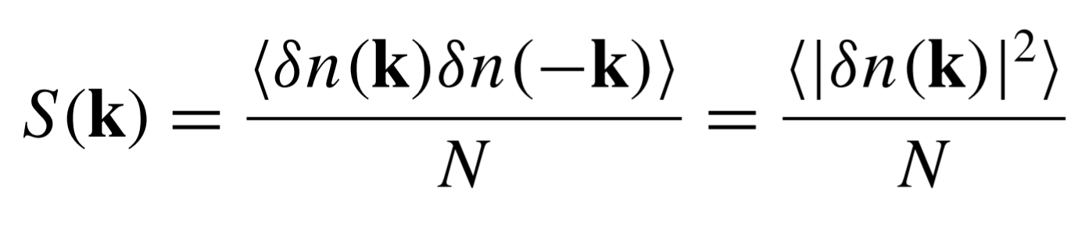
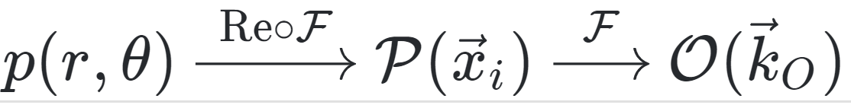
Some Equations
Eqn.8, Hung 2011
Eqn. 3, Hung 2011
Eqn. 4 and 5, Hung

Slide 19
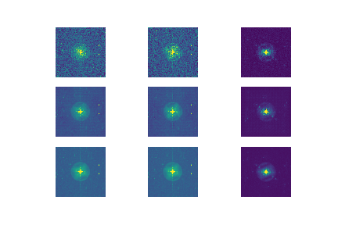
Result of NPS prediction
OD FFT
True Mean
Predicted Mean

Slide 20
Next Steps

